Slide 1
Electrical Power System
Opportunity

Slide 2
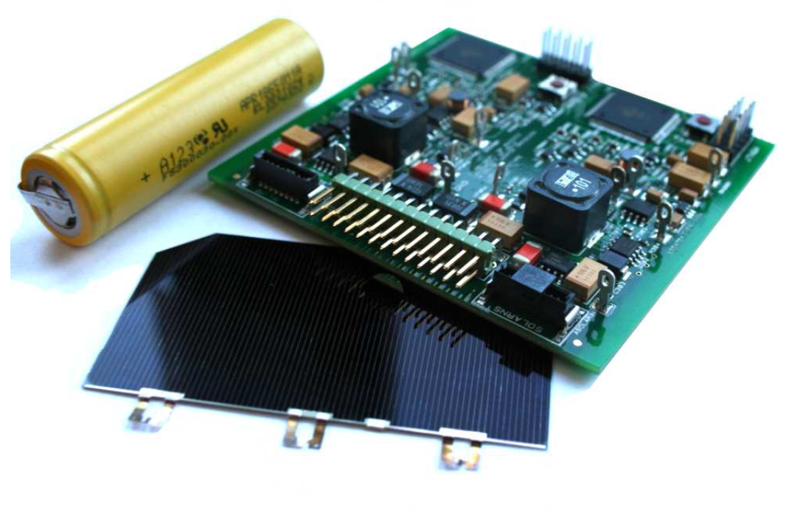
Power Conditioning, Monitoring and Distribution - EPS Board
Power Generation - Solar Panels
Power Storage - Batteries

Slide 3
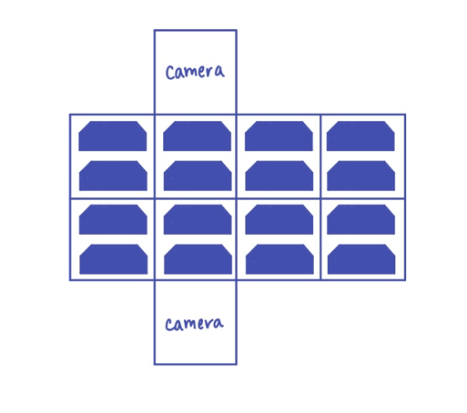
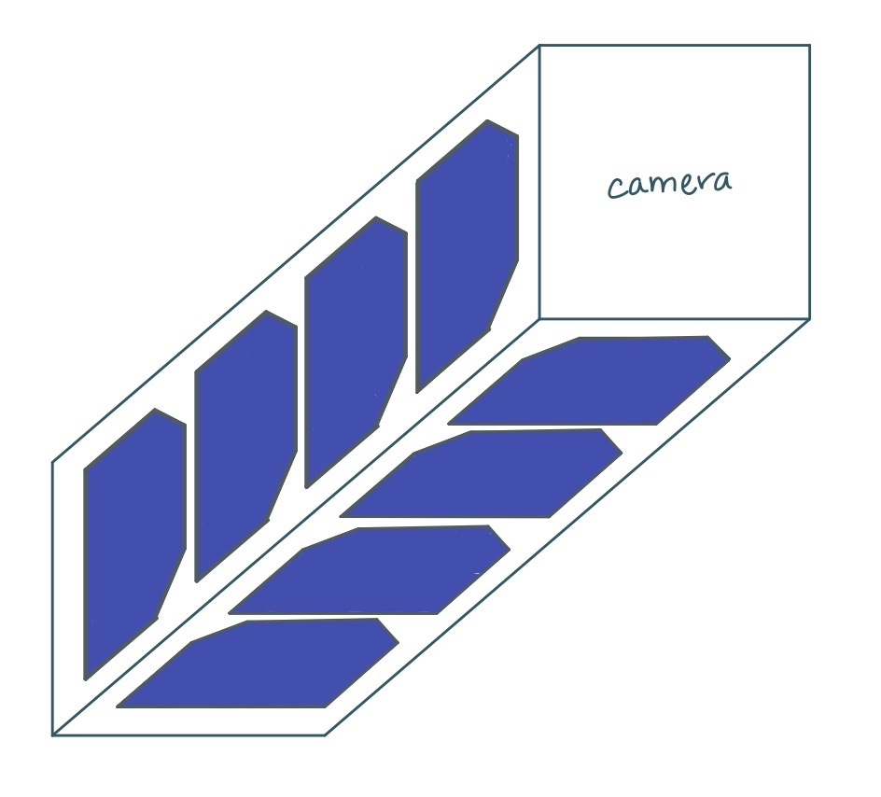
Generation of Power
Solar Panels Mounted on 4 sides
Limited Power Generated
Best Case: 6.5 W
Worst Case: 0 W
Specific Solar panels to be decided
Notes:
Notes:
The generation of power for the cubesat is vital to the mission, lack of power means the cubesat will not survive.
To generate sufficient power, solar panels are to be mounted on the four “long” sides and ideally will keep these sides facing the sun while spinning in the ideal “barbeque roll”
With this ideal orbit, the power generated would be 6.4 W per orbit (best case - having two panels facing the sun at 45 degrees each), and scenarios were conducted that found the worst case would be 0 W (with the camera facing the sun) There are multiple cases in between that were used for modelling
It should be mentioned that it is not possible for the EPS team to generate 6.5 W per orbit so teams should keep this in mind when designing their systems ** And this uses high amounts of attitude control so it is most likely not possible anyway
The specific brand of solar panel has not been decided as there are many types with minor adjustments and the best option has not been determined. This is not of major importance as the mass/size and generation efficiency does not change much between brands.

Slide 4

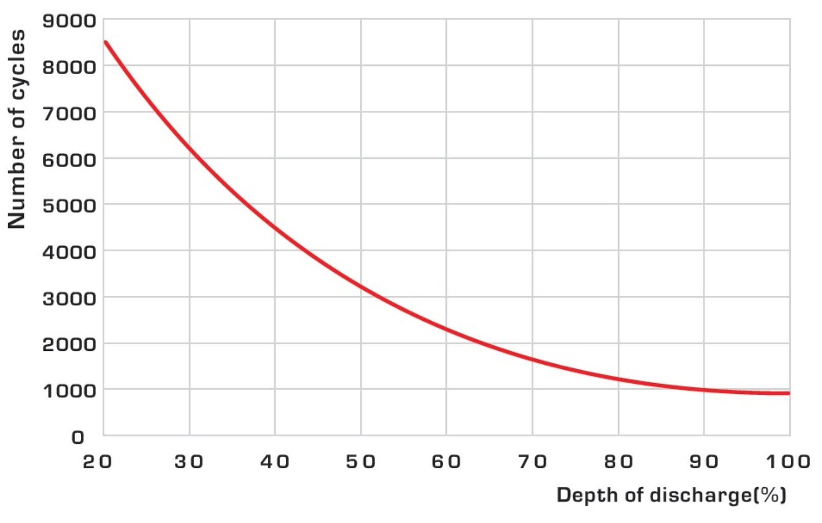
Power Storage - Batteries
Batteries provide supplementary power
There may be orbits where high power actions cannot be completed if batteries need charging
Depth of discharge: typically at 30% in LEO
4.5Wh needed for the orbit (1.6Wh in eclipse)
5300 cycles per year
5500 cycles:
with 50% capacity loss and 30% DOD
Notes:
Notes:
The benefit of the design of the power system is there is room/mass available to carry a battery, or even more
The batteries will allow the power system to supply more power than it can generate for a short duration.
It should also noted that not all orbits can be used to transmit data or take pictures (high uses of power) if the batteries need to be charged, as it is not good for their lifespan to drain more than 70% of their capacity

Slide 5
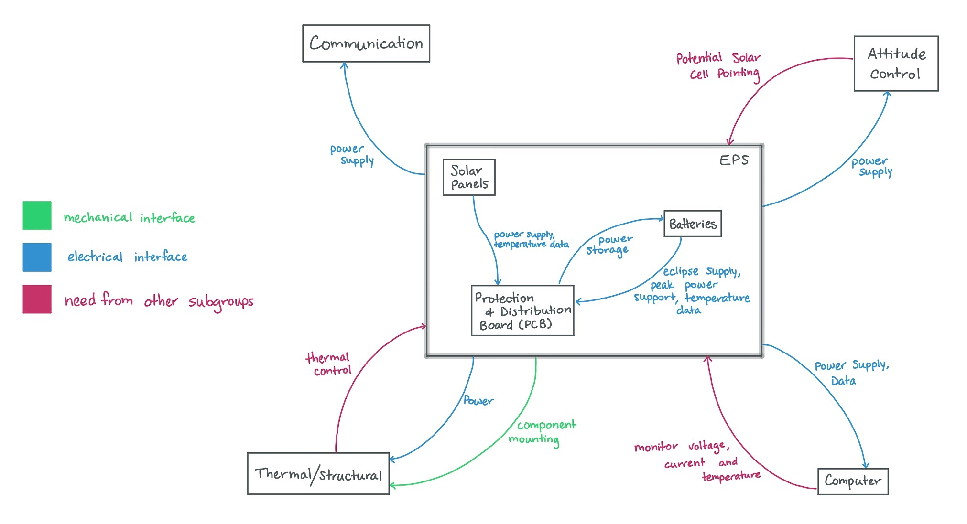
Interaction Map
Notes:
Notes:

Slide 6
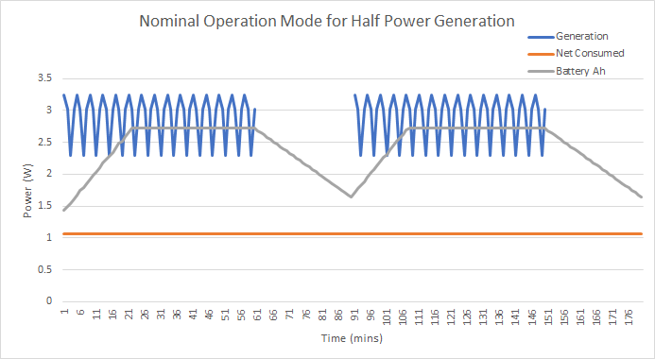
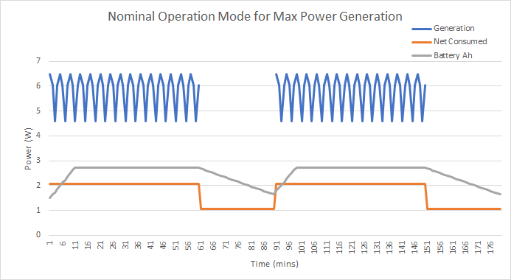
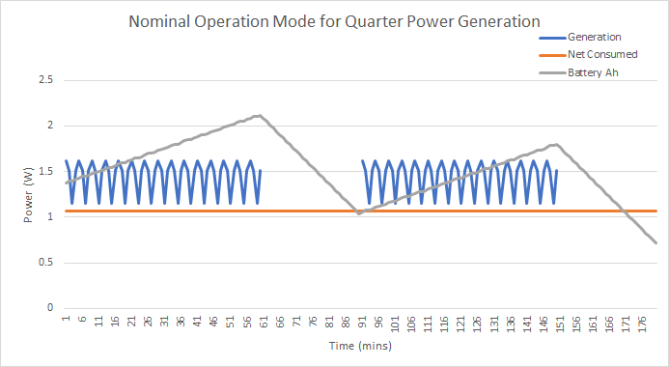
Power Modelling
Notes:
We are working on a model to compare different assumptions for the orientation of the cubesat and how this dictates the power generated by the solar panels. For example, in nominal mode the power consumed is constant throughout the orbit, so looking at using ADCS to keep the panels in the peak sunlight position we can this maximum amount of generation vs not using ADCS and assuming the natural rotation of the cubesat would put the panels in peak sunlight only half of the time.

Slide 7
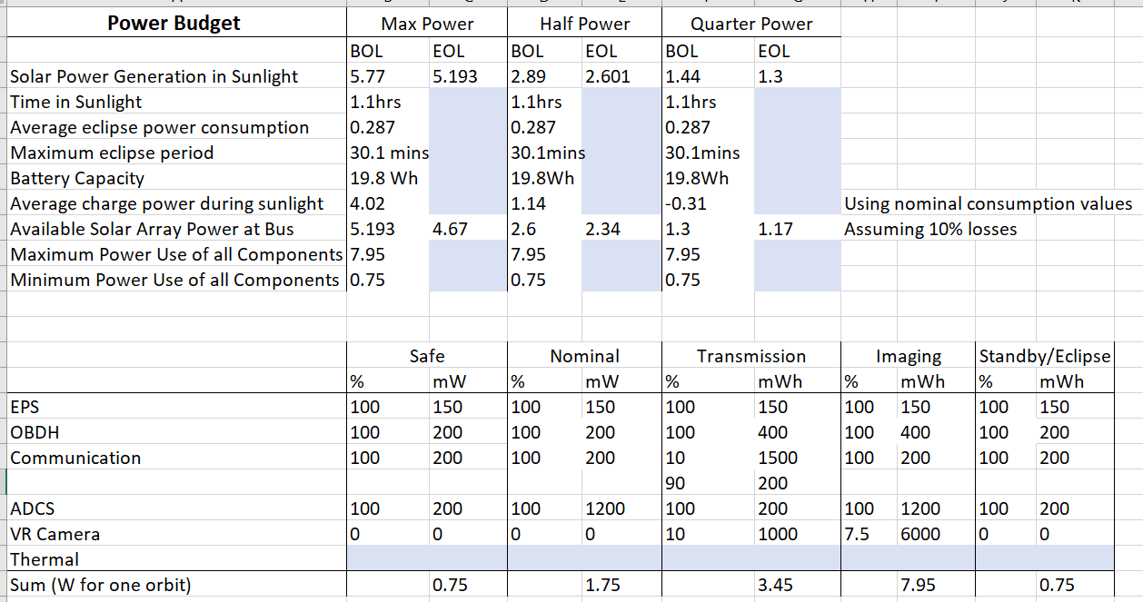
Power Budget
Notes:
Notes:
This power budget is an iterative process that is constantly changing as teams provide more detailed information about the power they require.
The information required by the EPS team is not just a wattage, but also the time required to be on and at what voltage or amperage. The time on required is vital as some teams require more wattage than the solar panels can generate, but they only need to be on for a short duration.
If there are any errors in the power budget please let us know

